Slide 1
Project 1 Global Warming – Fact or Fiction?
Danielle Dejean, Kaidon Kennedy, Carolyn Scheese, Harprett Singh
Notes:
Carolyn
Global Warming – Fact or Fiction??
Global warming: a phrase we've all heard and perhaps grown accustomed to, but today, let's unpack some data.
This session will unveil how artificial intelligence helps us understand the intricate dance between CO2 emissions and rising global temperatures—see what the data really tells us.
I’m Carolyn Scheese, and my team mates are: Danielle Dejean, Kaidon Kennedy, & Harprett Singh
And we are excited to present our project to you.
We had a lot of fun and learned a lot!
We hope you will enjoy our presentation.

Slide 2
Project Overview & Goals
Find and examine various environmental data to see the impact of CO2 for evidence of global warming and possible correlations by countries and continents throughout the world.
Explore the temperature and CO2 changes of different countries and different continents over a 25-year span (1995 – 2020)
Average temp over time by country and continent
Examine CO2 emissions as it relates to increases in surface temperature
Explore possible predication models for increases in average global temperature over various timelines; monthly, yearly, etc.
Notes:
Carolyn

Slide 3
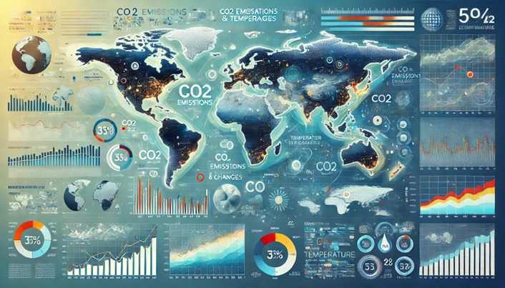
Data Sets
Global Warming Trends (1961-2022)
https://www.kaggle.com/datasets/jawadawan/global-warming-trends-1961-2022
Country, ISO code, Year and Temperature
Country wise surface temperature from 1961 to 2022
Countries and their Continents
https://www.kaggle.com/datasets/hserdaraltan/countries-by-continent
Temperature (1960) to Temperature (2022): annual surface temp (C) from1960 to 2022
Daily temperature of different cities with country a& Region
https://www.kaggle.com/datasets/subhamjain/temperature-of-all-countries-19952020
Contains data of various major cities of different countries in the world.
data.worldbank.org
World Bank Open Data
https://data.worldbank.org/indicator/EN.ATM.CO2E.PC?most_recent_year_desc=false
Free and open access to global development data
An image that represents an exploration of data from countries and continents across the world on CO2 and Temperatures across the world that can be used as a background in a PPT presentation; modern and professional style - Dalle
Kaggle – High Quality
Examined 4 data sets
Used 3 data sets
*excluded worldbank
No copywrite issues with this data
Notes:
Carolyn
We looked at several data sets beginning with Kaggle. We also explored other data sets from NASA and many others that we found by searching the internet.
We initially started with 2 data sets then decided that the data set from World Bank did not contain the information we were looking for, so we excluded it. We added additional 2 data sets from Kaggle.
We finally settled on 3 data sets from Kaggle
Global Warming Trends (1961-2022)
Country wise surface temperature from 1961 to 2022
2. Countries and their Continents
196 countries matched to their continent
3. Temp
3. Temperature of all countries from (1995-2020)

Slide 4
Data Collection, Cleanup & Exploration
Examined each data set, info & columns, size.
[Describe the collection,
exploration,
and cleanup process.]
Notes:
Danielle

Slide 5
Approach
Include any relevant code or demonstrations of the application or analysis.
Discuss any unanticipated insights or problems that arose and how you resolved them.]
Notes:
Danielle

Slide 6
Approach
[The approach that your group took to achieve the project goals:
Include any relevant code or demonstrations of the application or analysis.
Discuss any unanticipated insights or problems that arose and how you resolved them.]
Notes:
Danielle

Slide 7
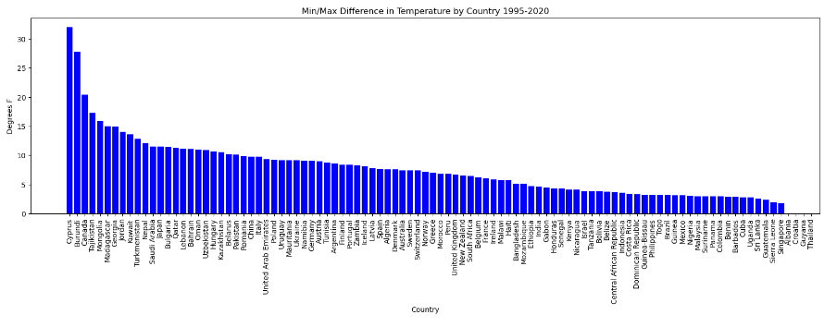
Min/ Max Difference in Temperature by Country 1995 – 2020
# Which country had the highest change in Temperature
# Plot a bar chart
plt.figure(figsize=(20,5))
plt.bar(x_axis, df_sorted["Temp_difference"], color='b', align="edge")
plt.xticks(tick_locations, df_sorted["Country"], rotation="vertical")
plt.title("Min/Max Difference in Temperature by Country 1995-2020")
plt.xlabel("Country")
plt.ylabel("Degrees F")
plt.show()
Coding Challenges
We had merged the database so it made the Pareto difficult to create
read in the column by the temp so we had to figure out
Notes:
Harpreet

Slide 8
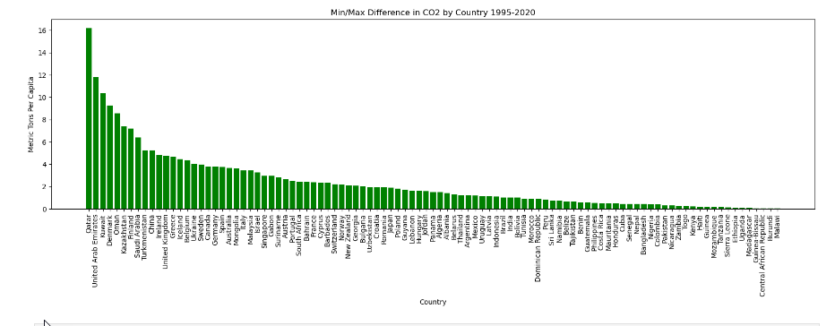
Min/ Max Difference in CO2 by Country 1995 – 2020
# Which country had the highest change in CO2
# Plot a bar chart
plt.figure(figsize=(20,5))
plt.bar(x_axis, df_sorted2["CO2_difference"], color='g', align="edge")
plt.xticks(tick_locations, df_sorted2["Country"], rotation="vertical")
plt.title("Min/Max Difference in CO2 by Country 1995-2020")
plt.xlabel("Country")
plt.ylabel("Metric Tons Per Capita")
plt.show()
According to the data, The county with the highest CO2 is: Qatar
Small country – very dependent on oil, natural gas and ground water
Desert, open.
The country with the lowest CO2 is Malawi
Small country –
Minerals and rain forests
Just below equator
Cyprus – highest in temperature , but near the middle in CO2 emissions
Notes:
Harpreet

Slide 9
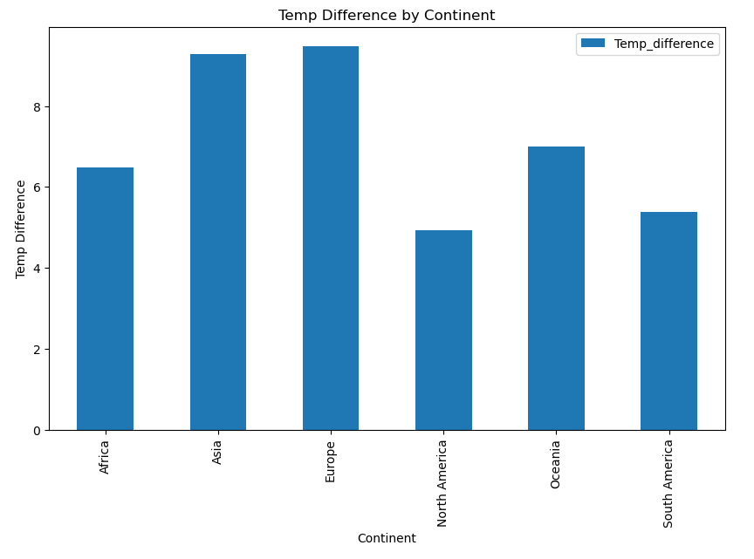
Max & Min (1995-2020) Temp Difference by Continent
[The approach that your group took to achieve the project goals:
Include any relevant code or demonstrations of the application or analysis.
Discuss any unanticipated insights or problems that arose and how you resolved them.]
# plt.figure(figsize=(20,5))
# plt.bar(x_axis, avg_temp_per_continent["Temp_difference"], color='b', align="edge")
# plt.xticks(tick_locations, avg_temp_per_continent["Continent"], rotation="vertical")
# avg_temp_per_continent.plot(kind = 'bar', y=‘)
bar_chart = avg_temp_per_continent.plot(kind='bar', x='Continent', figsize=(10, 6))
# Set the title and labels
bar_chart.set_title("Temp Difference by Continent")
bar_chart.set_xlabel("Continent")
bar_chart.set_ylabel("Temp Difference")
# Show the bar chart
bar_chart
Notes:
Harpreet

Slide 10
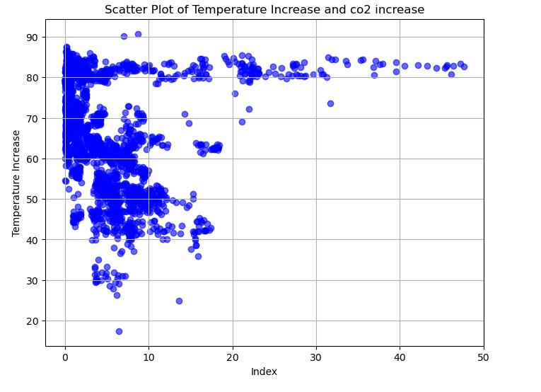
Scatter plot of temp & CO2 increase
[The approach that your group took to achieve the project goals:
Include any relevant code or demonstrations of the application or analysis.
Discuss any unanticipated insights or problems that arose and how you resolved them.]
# Create a scatter plot
plt.figure(figsize=(8, 6))
plt.scatter(avg_co2_temp_continent_country['CO2 emissions (metric tons per capita)'], avg_co2_temp_continent_country['YearlyAvgTemperature'], color='blue', alpha=0.6)
# Scatter plot with index on x-axis and Temp increase on y-axis
plt.xlabel('Index')
plt.ylabel('Temperature Increase')
plt.title('Scatter Plot of Temperature Increase and co2 increase')
plt.grid(True)
plt.show()
Notes:
Harpreet

Slide 11
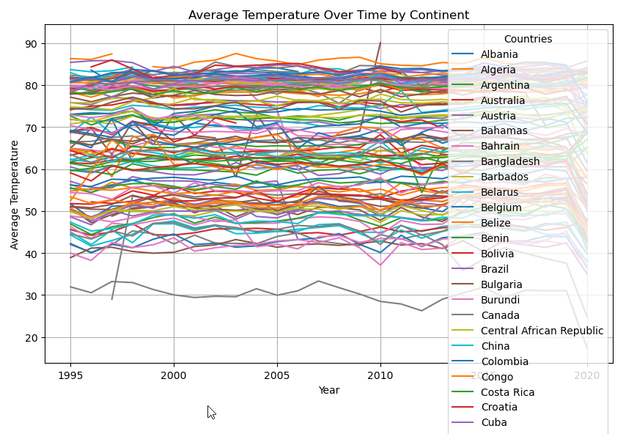
Average Temp over time by Country
[The approach that your group took to achieve the project goals:
Include any relevant code or demonstrations of the application or analysis.
Discuss any unanticipated insights or problems that arose and how you resolved them.]
# plotting the change in avg temp in countries over time
pivot_df = avg_temp_continent_country.pivot(index='Year', columns='Country', values='YearlyAvgTemperature')
# Plot
pivot_df.plot(kind='line', figsize=(10, 6))
plt.title('Average Temperature Over Time by Country')
plt.xlabel('Year')
plt.ylabel('Average Temperature')
plt.legend(title='Countries')
plt.grid(True)
plt.show()
Notes:
Harprett

Slide 12
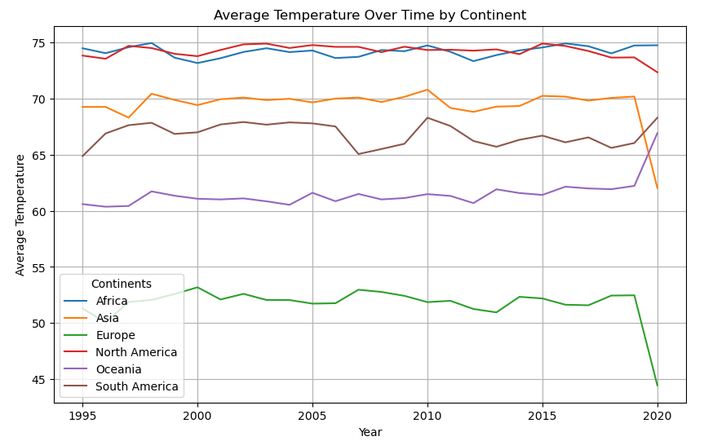
Average Temp over time by Continent
[The approach that your group took to achieve the project goals:
Include any relevant code or demonstrations of the application or analysis.
Discuss any unanticipated insights or problems that arose and how you resolved them.]
#now we just have to plot the new data set to see the change in avg temperatures in continents over 25 years
df_pivot = continent_avg_temps.pivot(index='Year', columns='Continent', values='YearlyAvgTemperature')
# Plot
df_pivot.plot(kind='line', figsize=(10, 6))
plt.title('Average Temperature Over Time by Continent')
plt.xlabel('Year')
plt.ylabel('Average Temperature')
plt.legend(title='Continents')
plt.grid(True)
plt.show()
Notes:
Kaidon

Slide 13
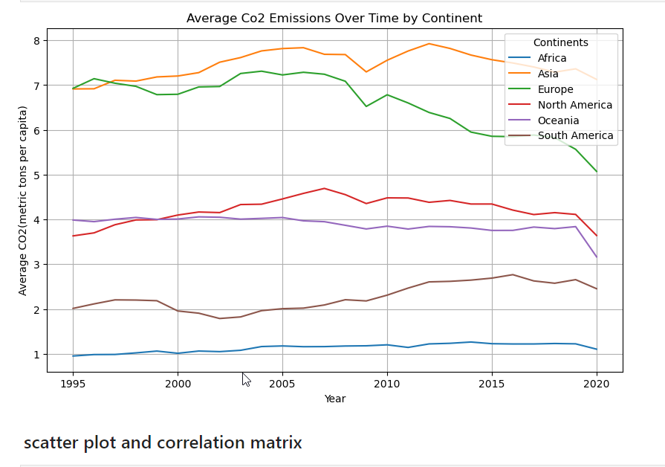
Average cO2 Emissions over time by Continent
[The approach that your group took to achieve the project goals:
Include any relevant code or demonstrations of the application or analysis.
Discuss any unanticipated insights or problems that arose and how you resolved them.]
# Plot
df_pivot_co2.plot(kind='line', figsize=(10, 6))
plt.title('Average Co2 Emissions Over Time by Continent')
plt.xlabel('Year')
plt.ylabel('Average CO2(metric tons per capita)')
plt.legend(title='Continents')
plt.grid(True)
plt.show()
Notes:
Kaidon

Slide 14
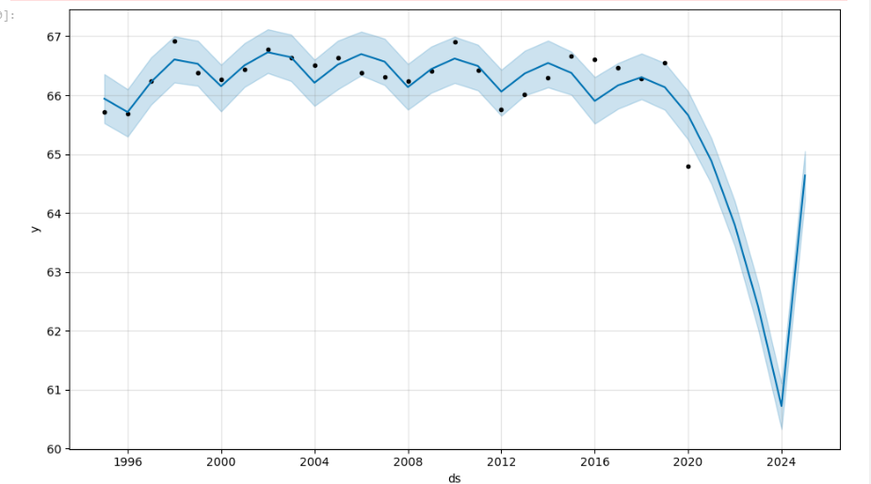
Forecasting
Needs labels
[The approach that your group took to achieve the project goals:
Include any relevant code or demonstrations of the application or analysis.
Discuss any unanticipated insights or problems that arose and how you resolved them.]
Needs revised code with labels
Notes:
Kaidon

Slide 15
Forecasting –
Needs labels
[The approach that your group took to achieve the project goals:
Include any relevant code or demonstrations of the application or analysis.
Discuss any unanticipated insights or problems that arose and how you resolved them.]
Needs revised code with labels
Notes:
Kaidon

Slide 16
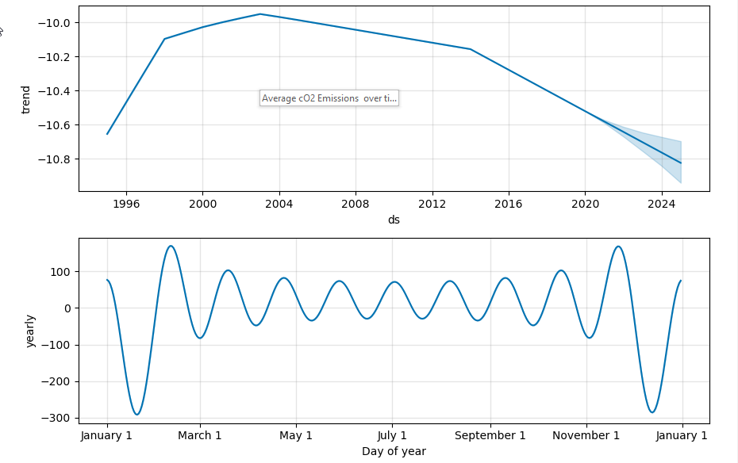
Forecasting
Needs labels
[The approach that your group took to achieve the project goals:
Include any relevant code or demonstrations of the application or analysis.
Discuss any unanticipated insights or problems that arose and how you resolved them.]
Needs revised code with labels
Notes:
Kaidon

Slide 17
Forecasting
Needs labels
[The approach that your group took to achieve the project goals:
Include any relevant code or demonstrations of the application or analysis.
Discuss any unanticipated insights or problems that arose and how you resolved them.]
Needs revised code with labels
Notes:
Kaidon

Slide 18
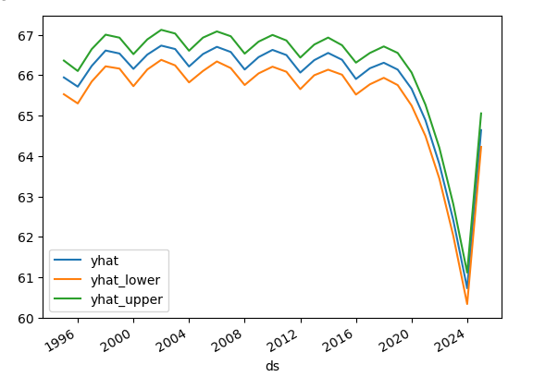
Forecasting
Needs labels
[The approach that your group took to achieve the project goals:
Include any relevant code or demonstrations of the application or analysis.
Discuss any unanticipated insights or problems that arose and how you resolved them.]
Needs revised code with labels
Notes:
Kaidon

Slide 19
Forecasting
Needs labels
[The approach that your group took to achieve the project goals:
Include any relevant code or demonstrations of the application or analysis.
Discuss any unanticipated insights or problems that arose and how you resolved them.]
Needs revised code with labels
Notes:
Kaidon

Slide 20
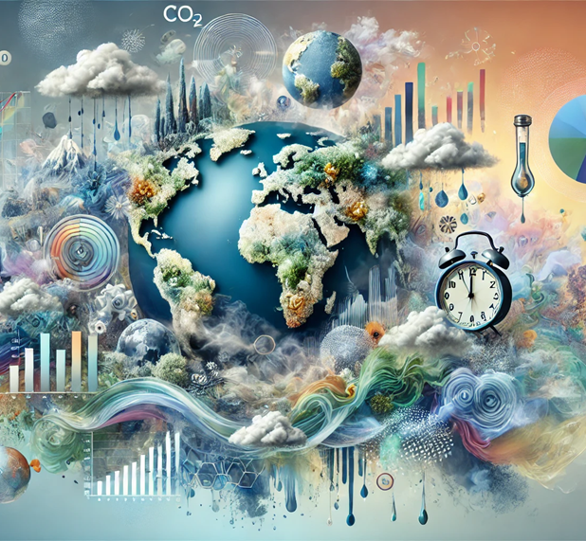
Next Steps
If we had more time, we would:
Get additional and better data to forecast temperature & CO2
Explore CO2 vs Methane
Explore change in water temperature
Explore inequity for which countries are most affected and which have the biggest discrepancies. GDP - reword???
Explore impact of population density/per capita.
Impact of COVID on CO2 - See dip in 2020 – CO2 over time by continent
Explore effect of electric car policies on production – CO2 levels –(country that manufactures vs country that purchases).(impact on 2020?)
Fit a linear regression line on the scatter plot correlation chart
Investigate the lag between the drastic change in CO2 levels and Temp
Explore the temp data for inconsistencies/ errors – 2 continents dropped dramatically
an image that represents an exploration of data from countries and continents across the world on CO2 and Temperatures across the world that can be used as a background in a PPT presentation; surrealism style – Dall-E
Notes:
Carolyn

Slide 21

Questions?
an image or symbol to represent asking questions - Dalle
Notes:
All

Slide 22
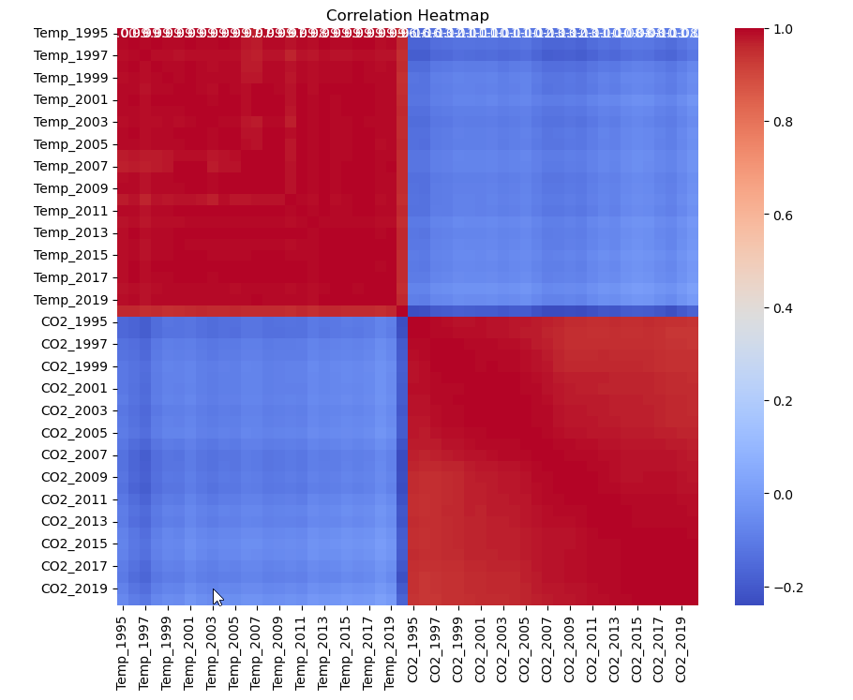
Backup: Correlation Heatmap
[The approach that your group took to achieve the project goals:
Include any relevant code or demonstrations of the application or analysis.
Discuss any unanticipated insights or problems that arose and how you resolved them.]
# see if there is a temp/CO2 correlation
Temp_CO2_Merged.drop(['Continent', 'Country', 'Temp_min', 'Temp_max', 'Temp_difference', 'CO2_min', 'CO2_max', 'CO2_difference'], axis=1, inplace=True)
display(Temp_CO2_Merged)
correlation_matrix = Temp_CO2_Merged.corr()
# Create a heatmap of the correlation matrix using Seaborn:
plt.figure(figsize=(10, 8))
sns.heatmap(correlation_matrix, annot=True, cmap='coolwarm', fmt=".2f")
plt.title('Correlation Heatmap')
plt.show()
Notes:
Danielle

